Slide 1
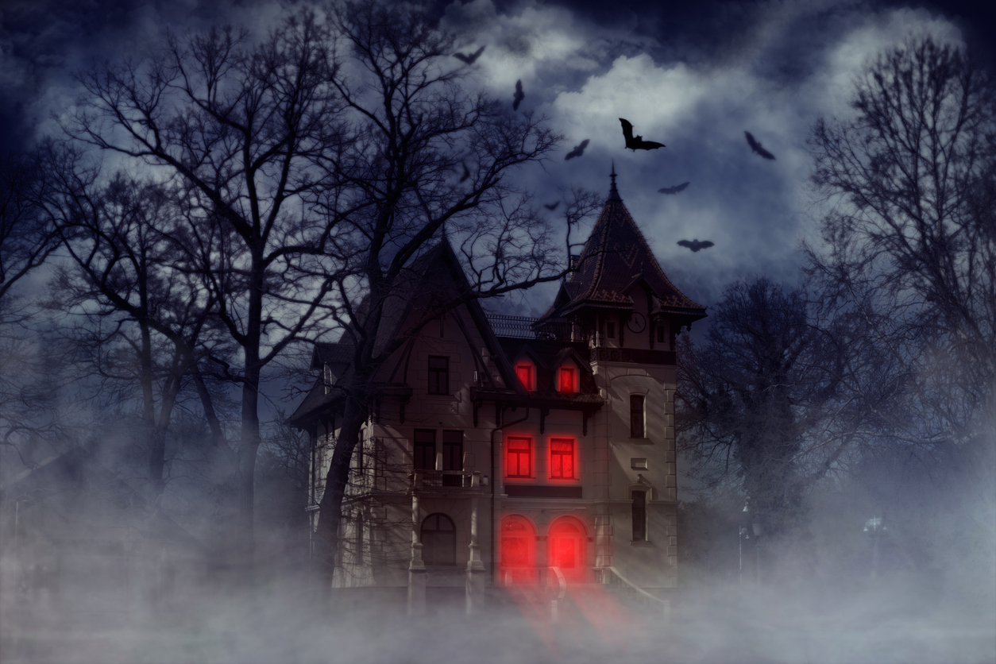

Emotion Regulation Strategy
Use and Forecasting Using Dynamic, Feature-Rich Stimuli
Billy Mitchell
Social Affective Neuroscience Lab
Notes:
I don’t have much time so I’m just going to hop right into it

Slide 2
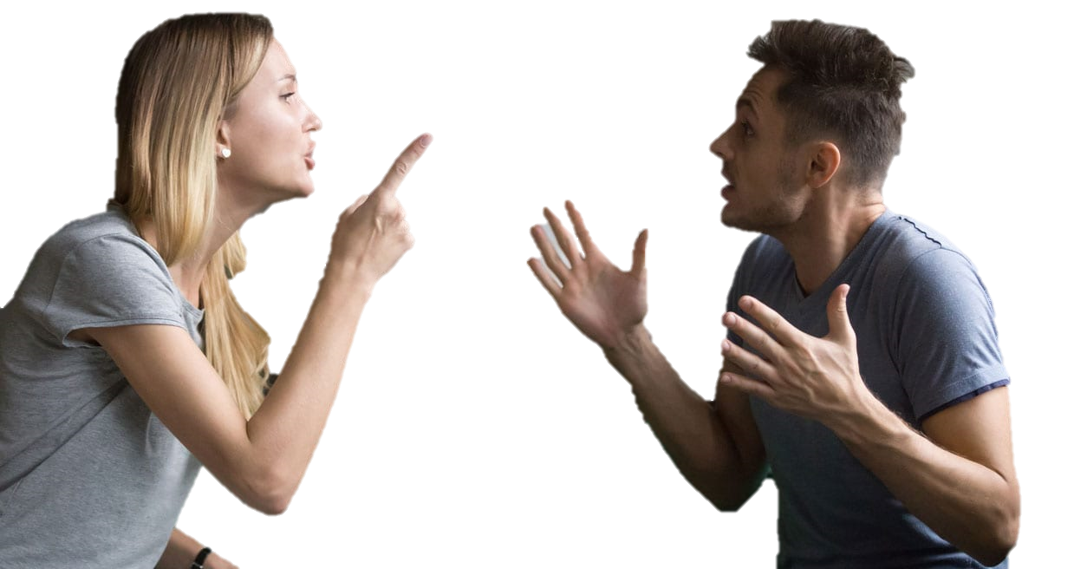
Notes:
Social conflict

Slide 3

Notes:
Physical threat

Slide 4

Events in our lives can be:
Intense
Notes:
Any other emotionally evocative stimuli

Slide 5

Events in our lives can be:
Intense
Uncertain

Slide 6

Events in our lives can be:
Intense
Uncertain
Dynamic

Slide 7

Events in our lives can be:
Intense
Uncertain
Dynamic
Complex

Slide 8
Regulation Strategy Use
Notes:
Realistic circumstances
Contextually sensitive

Slide 9
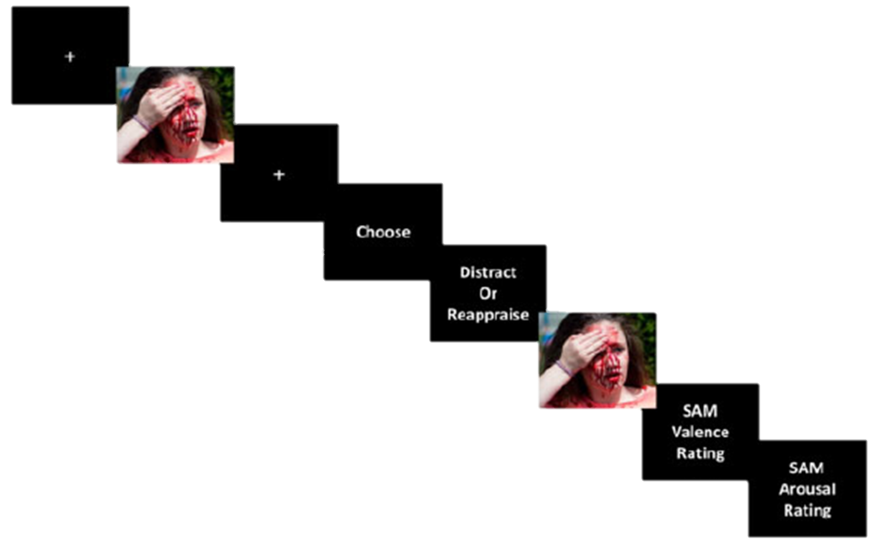
Regulation Strategy Choice
Regulation Strategy Use
Notes:
Idealized
Trained
Prompted

Slide 10


Regulation Strategy Choice
Regulation Strategy Use
Prioritizes Internal
Validity
Prioritizes
External
Validity

Slide 11

Regulation Strategy Choice
Regulation Strategy Use
Regulation Strategy Forecasting
Notes:
Existing somewhere in between having characteristics of each

Slide 12
What can Emotion Regulation Strategy Choice tell us about Use when events are intense, uncertain, dynamic, and complex?
If Use doesn’t match Choice, which is Forecasting more similar to?

Slide 13
Pilot
(N = 58)
Study 2
(N = 154)
Study 1
(N = 118)
Study 3
(N = 253)
Notes:
So the first thing we did in 2019 was a pilot study in which participants traversed the full 45 minute haunted house experience
We based our a priori power analysis on the most conservative effect size that we could observe at the time,
which suggested that we should be able to sufficiently power this study with just 18 participants.
Obviously given the additional complications
and the fact that others had questions that required greater power,
we aimed for 60 participants and got 58.

Slide 14
Pilot
(N = 58)
Study 2
(N = 154)
Instructed to experience haunted house naturally
No emotion regulation training
Identified ten most emotionally-salient events
Recorded affective intensity, regulation effort and described strategy in their own words for each event
Strategies were coded (IRR = 0.881)
Study 1
(N = 118)
Study 3
(N = 253)
Notes:
These participants were given minimal instructions and information before entering the haunted house.

Slide 15
Pilot
(N = 58)
Study 2
(N = 154)
Instructed to experience haunted house naturally
No emotion regulation training
Identified ten most emotionally-salient events
Recorded affective intensity, regulation effort and described strategy in their own words for each event
Strategies were coded (IRR = 0.881)
Study 1
(N = 118)
Study 3
(N = 253)
Notes:
Emotion regulation was never mentioned and participants were not trained in strategies

Slide 16
Pilot
(N = 58)
Study 2
(N = 154)
Instructed to experience haunted house naturally
No emotion regulation training
Identified ten most emotionally-salient events
Recorded affective intensity, regulation effort and described strategy in their own words for each event
Strategies were coded (IRR = 0.881)
Study 1
(N = 118)
Study 3
(N = 253)
Notes:
Instead, after the full experience,
participants were asked to self-identify ten events from the haunted house
that were most emotionally salient to them

Slide 17
Pilot
(N = 58)
Study 2
(N = 154)
Instructed to experience haunted house naturally
No emotion regulation training
Identified ten most emotionally-salient events
Recorded affective intensity, regulation effort and described strategy in their own words for each event
Strategies were coded (IRR = 0.881)
Study 1
(N = 118)
Study 3
(N = 253)
Notes:
They identified which emotions they felt from 14 options sourced from the PANAS,
how intense they felt those emotions,
and then, in a free response box,
were asked to describe how they attempted to self-regulate those emotions if they did at all.
They also completed a number of individual difference measures.

Slide 18
Pilot
(N = 58)
Study 2
(N = 154)
Instructed to experience haunted house naturally
No emotion regulation training
Identified ten most emotionally-salient events
Recorded affective intensity, regulation effort and described strategy in their own words for each event
Strategies were coded (IRR = 0.881)
Study 1
(N = 118)
Study 3
(N = 253)
Notes:
Those strategy responses were then coded by a team of independent,
hypothesis-blind raters trained to identify strategies.
And from there what I really wanted to establish was just whether this paradigm has any legs.
Can we study self-regulation in this way?
And so what did we find?

Slide 19
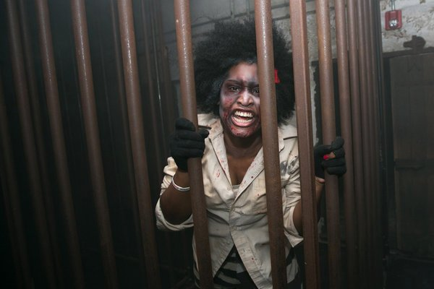
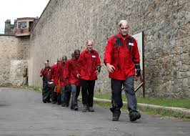
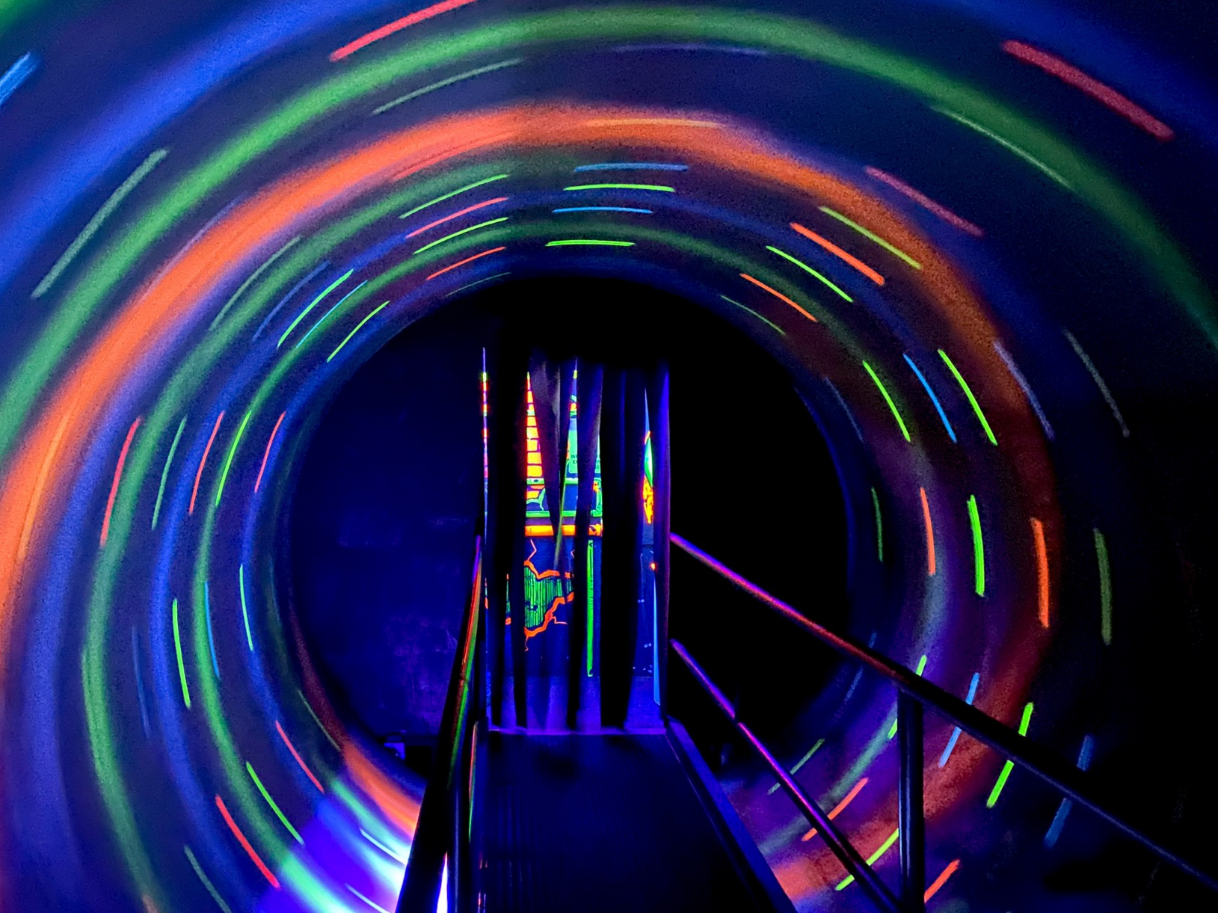
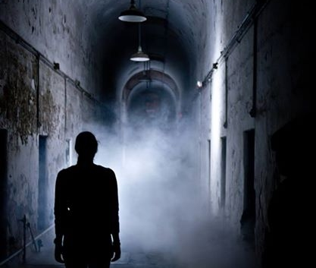

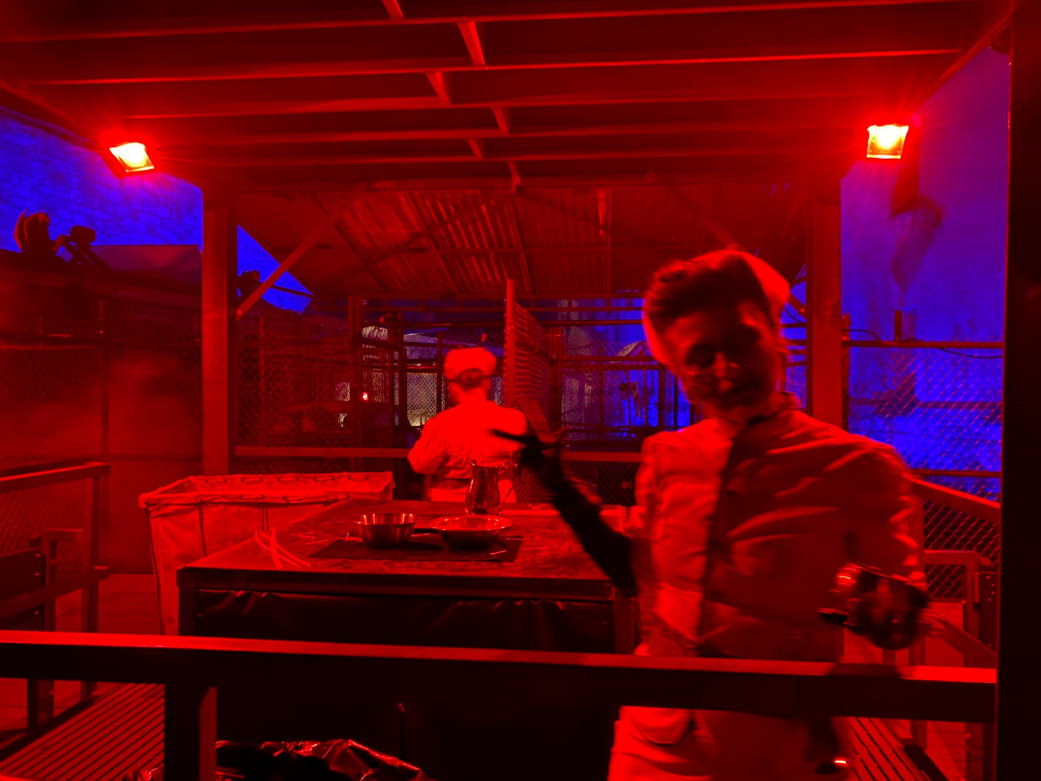
Notes:
And while this safety makes these situations categorically different from the threats I’d just talked about,
haunted house experiences incorporate all of the features that are otherwise hard to fit in a lab experiment.
They can be aversive, they are surprising, the events unfold over time, they often contain an ample and varied amount of auditory, visual, and sensory stimuli, and the events do not exist in isolation.
Here are a few examples of the sights that our participants experienced at Terror Behind the Walls, hosted at Eastern State Penitentiary in Philadelphia.

Slide 20
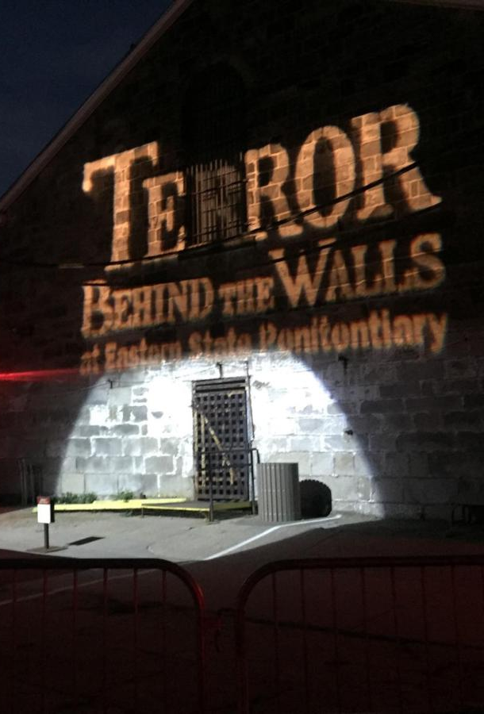
What can TBTW offer?
Feature-rich but controlled environment
Notes:
We chose Terror Behind the Walls as our setting for a few reasons
One, this environment can feel really overwhelming and chaotic, but it is completely controlled. Participants can feel in danger without being in any real danger

Slide 21
What can TBTW offer?
Feature-rich but controlled environment
Limited researcher intervention
Notes:
Relatedly, it can be very easy to forget that you are participating in a study at terror behind the walls.
Because of fantastic coordination between our team and the people operating this,
we did not need a lot of researcher participant interaction during exposure
And our participants could focus on trying to have as typical of a response as the situation would allow

Slide 22
What can TBTW offer?
Feature-rich but controlled environment
Limited researcher intervention
Performances are reliably consistent
Notes:
We did not need to worry about significant variance in participant experiences
The TBTW team let our participants skip lines to ensure that
all of their highly trained professional actors were in the same marks every time

Slide 23
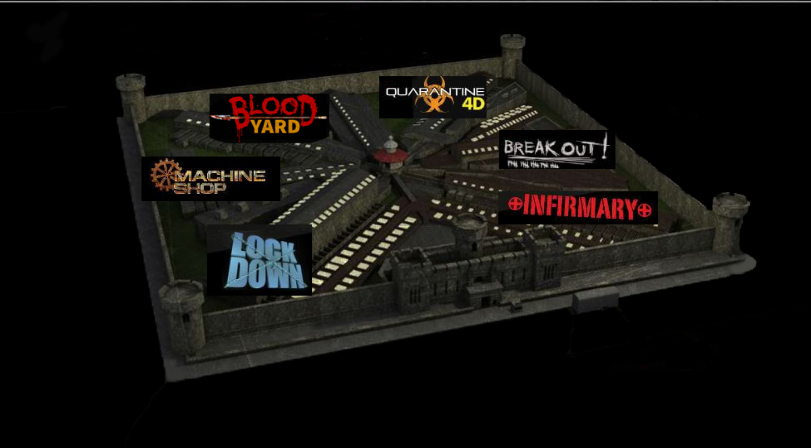
What can TBTW offer?
Feature-rich but controlled environment
Limited researcher intervention
Performances are reliably consistent
Great stimuli variability
Notes:
The TBTW experiences was divided into themed sections which provided a lot of different experiences
Making it likely that nearly everyone would have at least have a reaction to something

Slide 24
What can TBTW offer?
Feature-rich but controlled environment
Limited researcher intervention
Performances are reliably consistent
Great stimuli variability
Heightened complexity, dynamic interactions, and high-intensity threats in a safe environment
Notes:
and we found that degree to which participants reported highly intense affective responses while still being in no real danger
was far better than what we were able to achieve within the lab

Slide 25
When feeling intense emotions, people self-regulated
People who do not enjoy haunted houses report regulating more events within the haunted house. r² adj. = 0.242

Slide 26
When feeling intense emotions, people self-regulated
People who do not enjoy haunted houses regulate more events within the haunted house. r² adj. = 0.242

Slide 27
When feeling intense emotions, people self-regulated
People who do not enjoy haunted houses regulate more events within the haunted house. r² adj. = 0.242
As startle sensitivity increases, the number of regulated events within the haunted house increases. r² adj. = 0.085

Slide 28
When feeling intense emotions, people self-regulated
People who do not enjoy haunted houses regulate more events within the haunted house. r² adj. = 0.242
As startle sensitivity increases, the number of regulated events within the haunted house increases. r² adj. = 0.085

Slide 29
When feeling intense emotions, people self-regulated
People who do not enjoy haunted houses regulate more events within the haunted house. r² adj. = 0.242
As startle sensitivity increases, the number of regulated events within the haunted house increases. r² adj. = 0.085
As anxiety increased within the haunted house, so did participants’ self-reported efforts to emotionally regulate. r² adj. = 0.095

Slide 30
When feeling intense emotions, people self-regulated
People who do not enjoy haunted houses regulate more events within the haunted house. r² adj. = 0.242
As startle sensitivity increases, the number of regulated events within the haunted house increases. r² adj. = 0.085
As anxiety increased within the haunted house, so did participants’ self-reported efforts to emotionally regulate. r² adj. = 0.095

Slide 31
When feeling intense emotions, people self-regulated
People who do not enjoy haunted houses regulate more events within the haunted house. r² adj. = 0.242
As startle sensitivity increases, the number of regulated events within the haunted house increases. r² adj. = 0.085
As anxiety increased within the haunted house, so did participants’ self-reported efforts to emotionally regulate. r² adj. = 0.095
As negative affective intensity increased, people put more effort towards regulating their emotions.

Slide 32
When feeling intense emotions, people self-regulated
People who do not enjoy haunted houses regulate more events within the haunted house. r² adj. = 0.242
As startle sensitivity increases, the number of regulated events within the haunted house increases. r² adj. = 0.085
As anxiety increased within the haunted house, so did participants’ self-reported efforts to emotionally regulate. r² adj. = 0.095
As negative affective intensity increased for a given event, people put more effort towards regulating their emotions during that event.

Slide 33
Pilot
(N = 58)
Study 2
(N = 154)
Largely the same as Pilot except no time lag
Emotions were also free-response
Strategies were coded again (IRR = 0.877)
Instructed to experience haunted house naturally
No emotion regulation training
Identified ten most emotionally-salient events
Recorded affective intensity, regulation effort and described strategy in their own words for each event
Strategies were coded (IRR = 0.881)
Study 1
(N = 118)
Study 3
(N = 253)
Notes:
This time we included 118 people
Using observed effect from pilot
No time lag

Slide 34
Pilot
(N = 58)
Study 2
(N = 154)
Largely the same as Pilot except no time lag
Emotions were also free-response
Strategies were coded again (IRR = 0.877)
Instructed to experience haunted house naturally
No emotion regulation training
Identified ten most emotionally-salient events
Recorded affective intensity, regulation effort and described strategy in their own words for each event
Strategies were coded (IRR = 0.881)
Study 1
(N = 118)
Study 3
(N = 253)

Slide 35
Pilot
(N = 58)
Study 2
(N = 154)
Largely the same as Pilot except no time lag
Emotions were also free-response
Strategies were coded again (IRR = 0.877)
Instructed to experience haunted house naturally
No emotion regulation training
Identified ten most emotionally-salient events
Recorded affective intensity, regulation effort and described strategy in their own words for each event
Strategies were coded (IRR = 0.881)
Study 1
(N = 118)
Study 3
(N = 253)

Slide 36
We are certainly self-regulating, but how we do so is complicated ...
Affective intensity did not predict which strategy participants used when regulating their emotions in this context.

Slide 37
We are certainly self-regulating, but how we do so is complicated ...
Affective intensity did not predict which strategy participants used when regulating their emotions in this context.

Slide 38
We are certainly self-regulating, but how we do so is complicated ...
Affective intensity did not predict which strategy participants used when regulating their emotions in this context.
This was true even when taking a multiverse approach and adjusting for known covariates including cognitive load, sex, and ERQ scores.

Slide 39
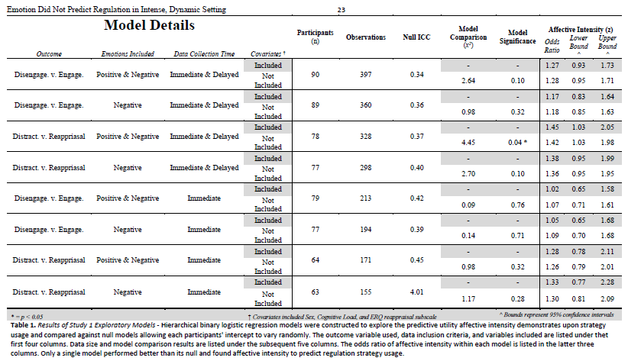

Slide 40
At least part of the reason that it may be complicated is that ...
Reappraisal performed about evenly at all levels of intensity, while distraction got worse as intensity increases
This is contrary to what previous lab research might suggest

Slide 41
At least part of the reason that it may be complicated is that ...
Reappraisal performed about evenly at all levels of intensity, while distraction got worse as intensity increases
This is contrary to what previous lab research might suggest

Slide 42
Pilot
(N = 58)
Study 2
(N = 154)
Largely the same as Pilot except no time lag
Emotions were also free-response
Strategies were coded again (IRR = 0.877)
Instructed to experience haunted house naturally
No emotion regulation training
Identified ten most emotionally-salient events
Recorded affective intensity, regulation effort and described strategy in their own words for each event
Strategies were coded (IRR = 0.881)
Conducted entirely online with people who had never seen the haunted house
Fed descriptions of events, affective information,
Asked to predict which strategy they would have used.
More closely mirrors the stimulus-response paradigms
Study 1
(N = 118)
Study 3
(N = 253)

Slide 43
Pilot
(N = 58)
Study 2
(N = 154)
Largely the same as Pilot except no time lag
Emotions were also free-response
Strategies were coded again (IRR = 0.877)
Instructed to experience haunted house naturally
No emotion regulation training
Identified ten most emotionally-salient events
Recorded affective intensity, regulation effort and described strategy in their own words for each event
Strategies were coded (IRR = 0.881)
Conducted entirely online with people who had never seen the haunted house
Fed descriptions of events, affective information
Asked to predict which strategy they would have used.
More closely mirrors the stimulus-response paradigms
Study 1
(N = 118)
Study 3
(N = 253)

Slide 44
Pilot
(N = 58)
Study 2
(N = 154)
Largely the same as Pilot except no time lag
Emotions were also free-response
Strategies were coded again (IRR = 0.877)
Instructed to experience haunted house naturally
No emotion regulation training
Identified ten most emotionally-salient events
Recorded affective intensity, regulation effort and described strategy in their own words for each event
Strategies were coded (IRR = 0.881)
Conducted entirely online with people who had never seen the haunted house
Fed descriptions of events, affective information
Asked to predict which strategy they would have used.
More closely mirrors the stimulus-response paradigms
Study 1
(N = 118)
Study 3
(N = 253)

Slide 45
Pilot
(N = 58)
Study 2
(N = 154)
Largely the same as Pilot except no time lag
Emotions were also free-response
Strategies were coded again (IRR = 0.877)
Instructed to experience haunted house naturally
No emotion regulation training
Identified ten most emotionally-salient events
Recorded affective intensity, regulation effort and described strategy in their own words for each event
Strategies were coded (IRR = 0.881)
Conducted entirely online with people who had never seen the haunted house
Fed descriptions of events, affective information
Asked to predict which strategy they would have used.
More closely mirrors the stimulus-response paradigms
Study 1
(N = 118)
Study 3
(N = 253)

Slide 47
When forecasting emotion regulation ...
We see a similar pattern of results to what ER researchers have canonically found (albeit, a much weaker association); increased affective intensity predicts a greater likelihood of selecting distraction instead of reappraisal
OR = 1.06, 95% CI = [1.02, 1.10], p = 0.004
Notes:
, likely because Forecasters were specifically using the strategy at higher intensities; the situation which experiencers found themselves the least likely to successfully deploy distraction.
, which might makes sense if we have one group effectively choosing reappraisal at chance

Slide 48
When forecasting emotion regulation ...
We see a similar pattern of results to what ER researchers have canonically found (albeit, a much weaker association); increased affective intensity predicts a greater likelihood of selecting distraction instead of reappraisal
OR = 1.06, 95% CI = [1.02, 1.10], p = 0.004
These differences were not explained by differences between the samples in ERQ, DERS, or IUS
Notes:
, likely because Forecasters were specifically using the strategy at higher intensities; the situation which experiencers found themselves the least likely to successfully deploy distraction.
, which might makes sense if we have one group effectively choosing reappraisal at chance

Slide 49
When forecasting emotion regulation ...
We see a similar pattern of results to what ER researchers have canonically found (albeit, a much weaker association); increased affective intensity predicts a greater likelihood of selecting distraction instead of reappraisal
OR = 1.06, 95% CI = [1.02, 1.10], p = 0.004
These differences were not explained by differences between the samples in ERQ, DERS, or IUS
Forecasters matched Reappraisal at about chance. However, forecasters were much less accurate in matching Distraction, adjusting for frequency differences.
Notes:
, likely because Forecasters were specifically using the strategy at higher intensities; the situation which experiencers found themselves the least likely to successfully deploy distraction.
, which might makes sense if we have one group effectively choosing reappraisal at chance

Slide 50

Pilot
(N = 58)
Study 2
(N = 154)
Largely the same as Pilot except no time lag
Emotions were also free-response
Strategies were coded again (IRR = 0.877)
Conducted online using horror movie stimuli
Seeks to disentangle the forecasting/experiencing and stimulation –level
confound
Instructed to experience haunted house naturally
No emotion regulation training
Identified ten most emotionally-salient events
Recorded affective intensity, regulation effort and described strategy in their own words for each event
Strategies were coded (IRR = 0.881)
Conducted entirely online with people who had never seen the haunted house
Fed descriptions of events, affective information,
Asked to predict which strategy they would have used.
More closely mirrors the stimulus-response paradigms
Study 1
(N = 118)
Study 3
(N = 253)

Slide 51
Pilot
(N = 58)
Study 2
(N = 154)
Largely the same as Pilot except no time lag
Emotions were also free-response
Strategies were coded again (IRR = 0.877)
Conducted online using horror movie stimuli
Captured both forecasting and experiencing usage using high and low intensity stimuli
Instructed to experience haunted house naturally
No emotion regulation training
Identified ten most emotionally-salient events
Recorded affective intensity, regulation effort and described strategy in their own words for each event
Strategies were coded (IRR = 0.881)
Conducted entirely online with people who had never seen the haunted house
Fed descriptions of events, affective information,
Asked to predict which strategy they would have used.
More closely mirrors the stimulus-response paradigms
Study 1
(N = 118)
Study 3
(N = 253)

Slide 52
Pilot
(N = 58)
Study 2
(N = 154)
Largely the same as Pilot except no time lag
Emotions were also free-response
Strategies were coded again (IRR = 0.877)
Conducted online using horror movie stimuli
Captured both forecasting and experiencing usage using high and low intensity stimuli
Mirrored many aspects of Study 1
Instructed to experience haunted house naturally
No emotion regulation training
Identified ten most emotionally-salient events
Recorded affective intensity, regulation effort and described strategy in their own words for each event
Strategies were coded (IRR = 0.881)
Conducted entirely online with people who had never seen the haunted house
Fed descriptions of events, affective information,
Asked to predict which strategy they would have used.
More closely mirrors the stimulus-response paradigms
Study 1
(N = 118)
Study 3
(N = 253)

Slide 53
When comparing usage and forecasting in more controlled circumstances...
At lower intensities, forecasters are less likely to select reappraisal than experiencers were to use reappraisal.
OR = 0.61, 95% CI = [0.39, 0.95], p = 0.029
Notes:
, likely because Forecasters were specifically using the strategy at higher intensities; the situation which experiencers found themselves the least likely to successfully deploy distraction.
, which might makes sense if we have one group effectively choosing reappraisal at chance

Slide 54
When comparing usage and forecasting in more controlled circumstances...
At lower intensities, forecasters are less likely to select reappraisal than experiencers were to use reappraisal.
OR = 0.61, 95% CI = [0.39, 0.95], p = 0.029
Notes:
, likely because Forecasters were specifically using the strategy at higher intensities; the situation which experiencers found themselves the least likely to successfully deploy distraction.
, which might makes sense if we have one group effectively choosing reappraisal at chance

Slide 55
When comparing usage and forecasting in more controlled circumstances...
[
At lower intensities, forecasters are less likely to select reappraisal than experiencers were to use reappraisal.
OR = 0.61, 95% CI = [0.39, 0.95], p = 0.029
Notes:
, likely because Forecasters were specifically using the strategy at higher intensities; the situation which experiencers found themselves the least likely to successfully deploy distraction.
, which might makes sense if we have one group effectively choosing reappraisal at chance

Slide 56
When comparing usage and forecasting in more controlled circumstances...
At lower intensities, forecasters are less likely to select reappraisal than experiencers were to use reappraisal.
OR = 0.61, 95% CI = [0.39, 0.95], p = 0.029
Forecasters were much more likely to select regulation over forecasters
Notes:
, likely because Forecasters were specifically using the strategy at higher intensities; the situation which experiencers found themselves the least likely to successfully deploy distraction.
, which might makes sense if we have one group effectively choosing reappraisal at chance

Slide 57
When comparing usage and forecasting in more controlled circumstances...
At lower intensities, forecasters are less likely to select reappraisal than experiencers were to use reappraisal.
OR = 0.61, 95% CI = [0.39, 0.95], p = 0.029
Forecasters were much more likely to select regulation over forecasters
However, forecasters used the strategies much more evenly than did experiencers, who relied more on reappraisal.
Notes:
, likely because Forecasters were specifically using the strategy at higher intensities; the situation which experiencers found themselves the least likely to successfully deploy distraction.
, which might makes sense if we have one group effectively choosing reappraisal at chance

Slide 58
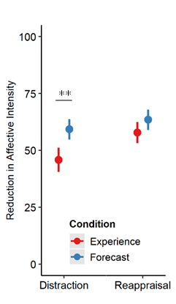
When comparing usage and forecasting in more controlled circumstances...
Forecasters predicted that distraction would reduce affective intensity when used more than experiencers reported that it actually had.
x̄ _{Experience} = 48.0 | x̄ _{Forecast} = 58.3
95% CI = [-16.62, -4.13]
t(198.2) = -3.28, p = 0.001
Notes:
, likely because Forecasters were specifically using the strategy at higher intensities; the situation which experiencers found themselves the least likely to successfully deploy distraction.
, which might makes sense if we have one group effectively choosing reappraisal at chance

Slide 59
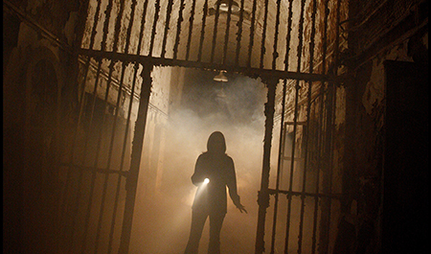
When events are …
Aversive
Uncertain
Dynamic
Complex
People spontaneously self-regulated their emotions
How people self-regulate their emotions is not significantly predicted by individual differences, affective intensity, cognitive load, or any other factor we commonly examine in the lab
Forecasting may still reflect the canonical regulation relationships, which raises questions of how environmental affordances, such as time to process, influence everyday self-regulation
Distraction was consistently less effective in use than might be expected by choice paradigms or forecasters.

Slide 60

Notes:
But I should also be very up front about our limitations

Slide 61
Self-selection bias
Notes:
We cannot deny the likelihood that some self-selection bias was at play here.
We tried our best to monitor this and test this. We did find quite a bit of diversity in the distribution of participant responses to questions like “How much do you enjoy or are fearful of haunted houses?”
We captured participant expectations and motivations for participation. But no matter what

Slide 62
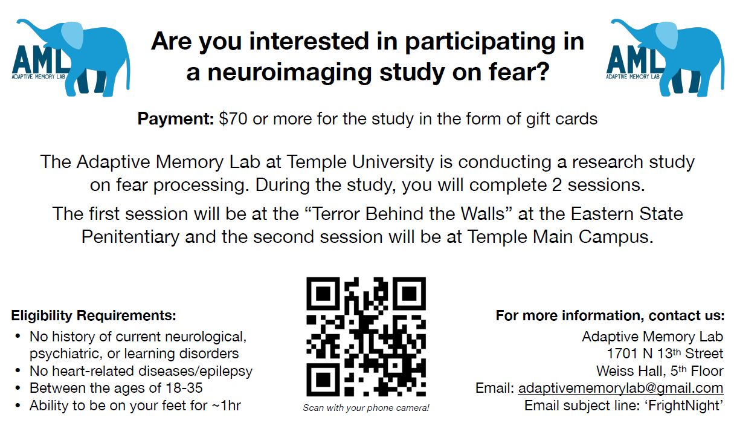
Notes:
When you advertise for a study on fear at a nationally famous haunted house
You have to assume certain types of participants are not responding to the ad

Slide 63
Self-selection bias
Still an artificial setting that might not generalize to daily life
Notes:
Although I believe that this design incorporates many of those features that I think to be important, it still is a fundamentally artificial environment.
When describing it, I’m hesitant to call it quasi-naturalistic and in fact often prefer something like “Dynamic and Feature-rich”

Slide 64

Self-selection bias
Still an artificial setting that might not generalize to daily life
Very resource intensive
Notes:
This was also a very resource intensive project which would not be possible without us being a very fortunate position to have received NSF funding for this project

Slide 65
Self-selection bias
Still an artificial setting that might not generalize to daily life
Very resource intensive
Difficult to execute / coordinate
Notes:
This project also required a ton of coordination, not only within the lab but with the folks running the attraction as well.

Slide 66
Self-selection bias
Still an artificial setting that might not generalize to daily life
Very resource intensive
Difficult to execute / coordinate
Difficult to analyze
Notes:
And lastly much of the data existed as free response and free recall data which required quite a lot of coding, and natural language processing to make usable

Slide 67
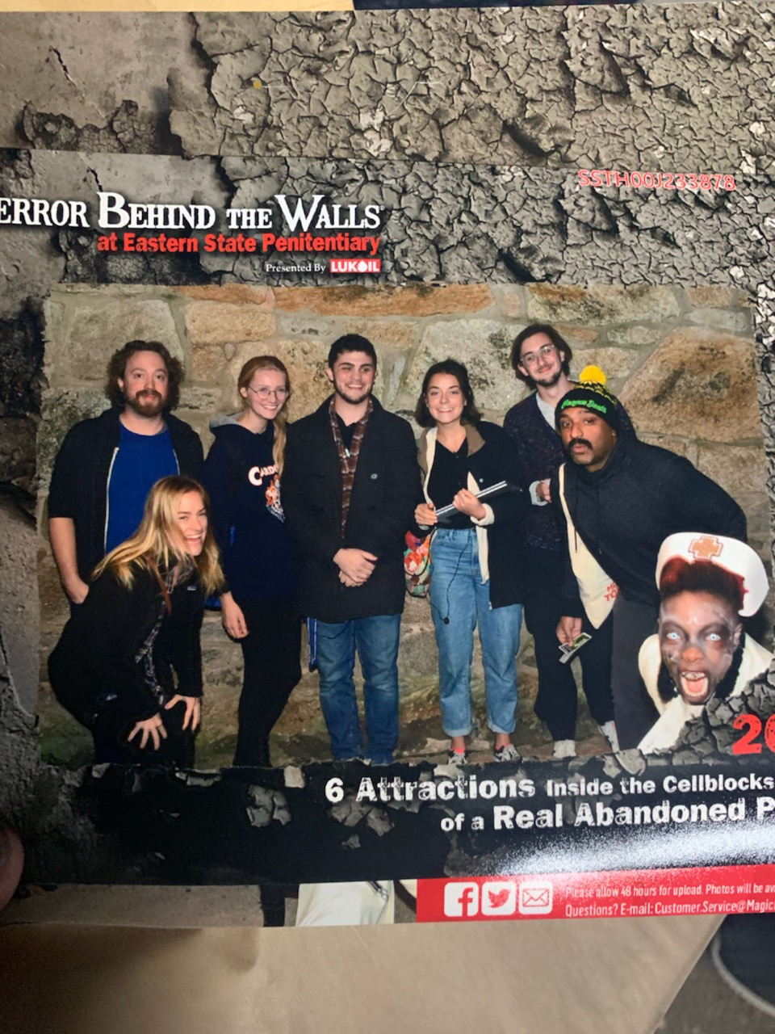

Sincere Appreciation to:
(Organized Alphabetically)
SAN Lab
Adhya Gowda
Chelsea Helion
Ian O’Shea
Helen Schmidt
Joanne Stasiak
AML Lab
Katelyn Cliver
Emily Cowan
Devlin Eckardt
Matthew Fain
Nicole Gonzalez
Dave Gregory
Kathryn Lockwood
Steven Martinez
Deepu Murty
Sam Reisman
Jane Rothrock
Notes:
Lastly, I just want to make sure to thank the people that helped me with this presentation and helped us build this project, between running sessions, data collections, scans, and analyzing. It really took a small army to pull off, and there were a lot of people that helped in big and small ways, so thank you to all of the members of the SAN Lab and the AML Lab.

Slide 68
QUESTIONS?

Slide 69
Greater study of environmental affordances
More naturalistic or high-immersion experiments
More meta-analyses to establish construct validity
Where to go from here?

Slide 70
Setting: Eastern State Penitentiary in Philadelphia Pennsylvania 2019 (Study 1)
A ~45 minute haunted house experience divided into six distinctly-themed sections featuring dozens of actors on a pre-determined course filled with traps, fences, props, mazes, etc.

Slide 71
Setting: Eastern State Penitentiary in Philadelphia Pennsylvania 2022 (Study 2)
RENAMED
REMOVED
REMOVED
A ~35 minute haunted house experience divided into four distinctly-themed sections featuring dozens of actors on a pre-determined course filled with traps, fences, props, mazes, etc.

Slide 72




Data Collected
Physiology
Self-Report
Behavior
fMRI imaging

Slide 73
How am I conceptualizing threat in this context?
Setting Design
Labels made by creators
Number of relevant events
Self-Report
State STAI
Custom Measures
Cognitive Load (indirectly)
Physiology
Increased Heart Rate
Decreased Heart Rate Variability

Slide 74
Data Collected
Physiology
Self-Report
Behavior

Slide 75
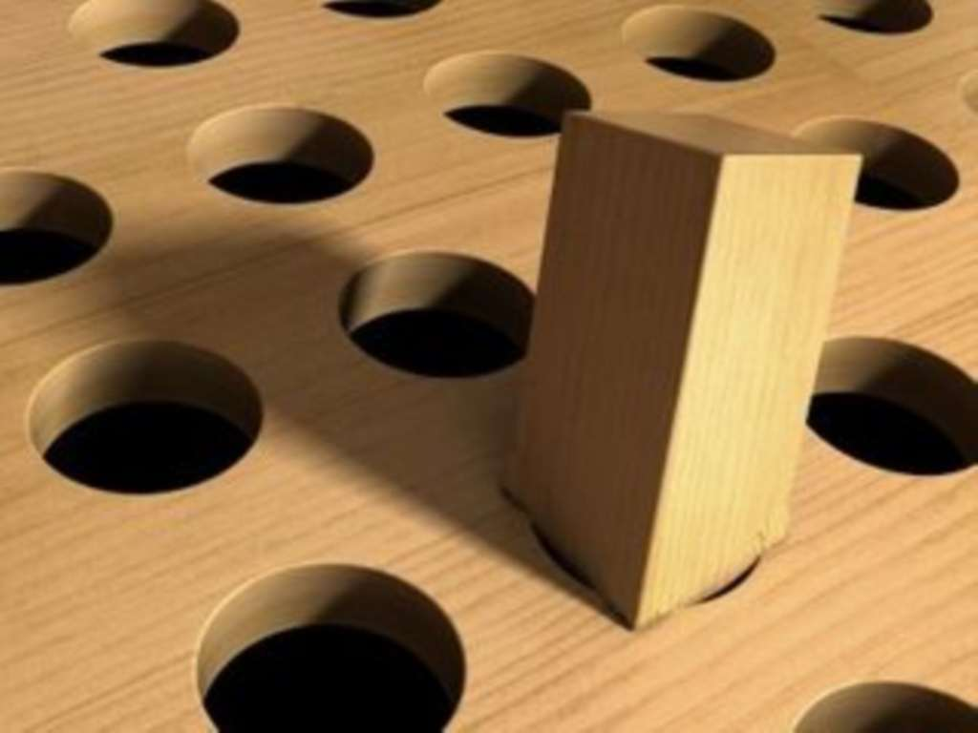
Some of these questions were not originally conceptualized through a threat framework specifically

Slide 76
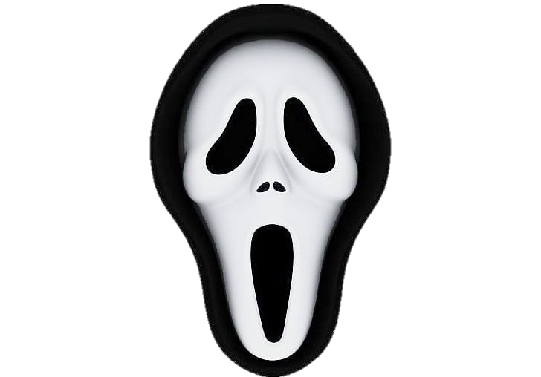

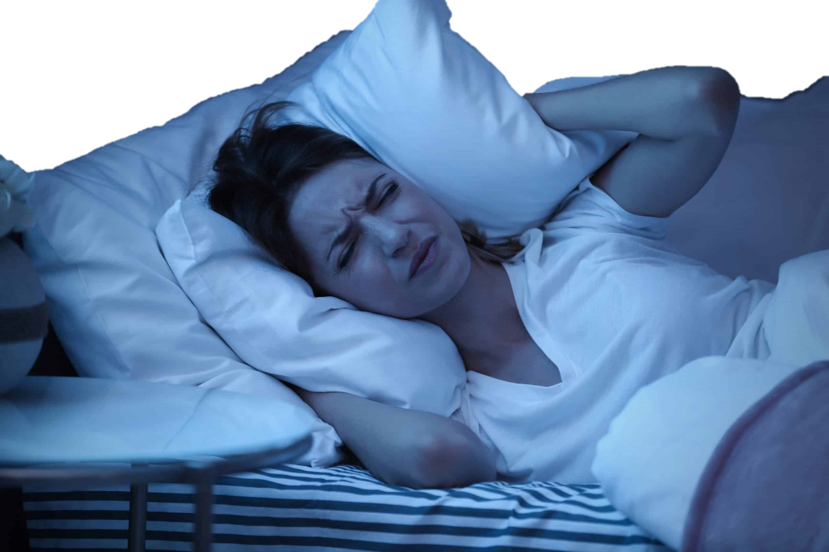
What did this project teach us happens …
During threats
After threats
Emotion regulation is complex and colored by environmental affordances
Memory accuracy improves for some things and worsens for others

Slide 77
Memory Under Threat
Memories under threat, broadly, are prone to distortions, while memory confidence often remains in tact
Threat-related arousal can bias individuals to forget contextual information linking peripheral information of an item to its surrounding context in memory

Slide 78
Memory Under Threat
Memories under threat, broadly, are prone to distortions, while memory confidence often remains in tact
Threat-related arousal can bias individuals to forget contextual information linking peripheral information of an item to its surrounding context in memory
Most research has focused on threat-related disruptions to item-spatial binding or item-item binding, but not item-temporal context binding.

Slide 79
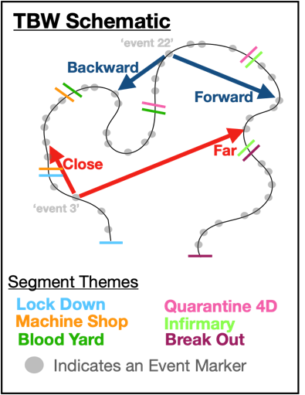
Memory Under Threat
Forward Transition
Proportion of events recalled backwards or forwards from last event in memory
Memories under threat, broadly, are prone to distortions, while memory confidence often remains in tact
Threat-related arousal can bias individuals to forget contextual information linking peripheral information of an item to its surrounding context in memory
Most research has focused on threat-related disruptions to item-spatial binding or item-item binding, but not item-temporal context binding.

Slide 80


Memory Under Threat
Forward Transition
Proportion of events recalled backwards or forwards from last event in memory
Memories under threat, broadly, are prone to distortions, while memory confidence often remains in tact
Threat-related arousal can bias individuals to forget contextual information linking peripheral information of an item to its surrounding context in memory
Most research has focused on threat-related disruptions to item-spatial binding or item-item binding, but not item-temporal context binding.

Slide 81
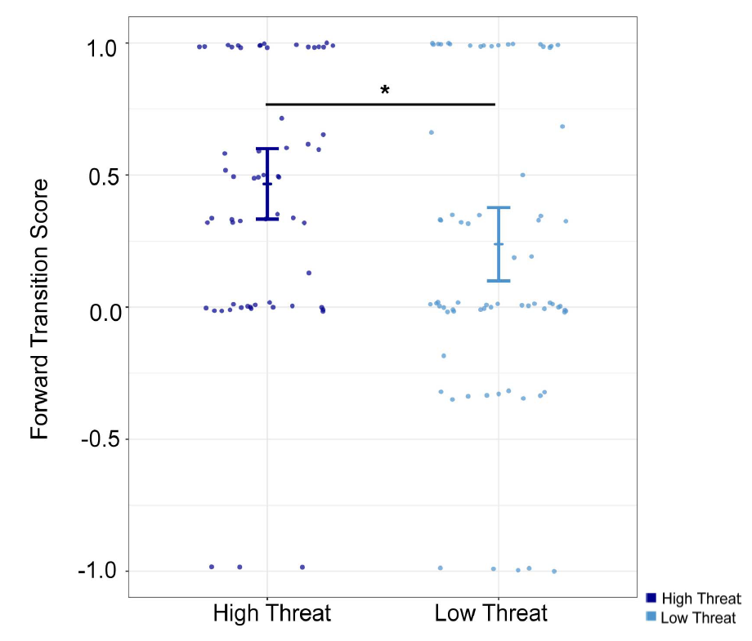
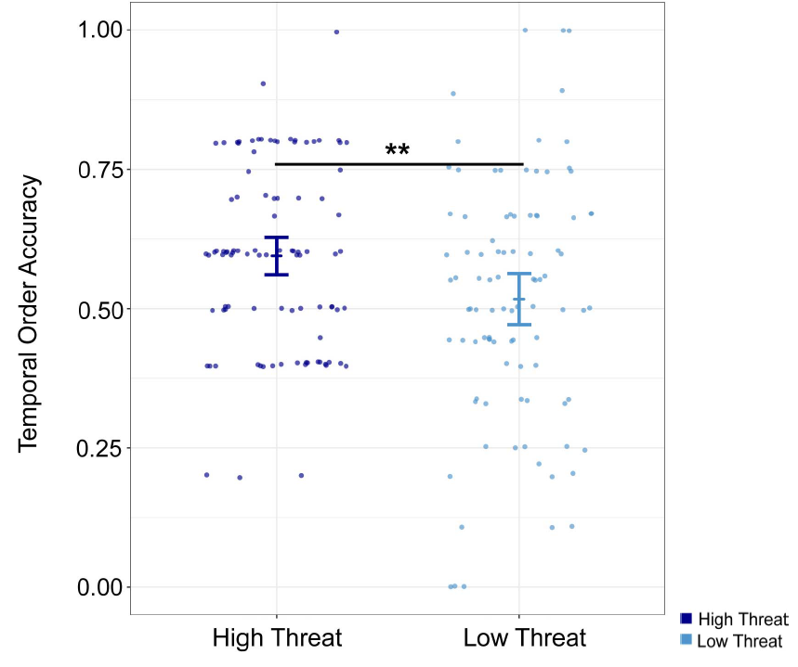
Threat improved temporal order memory (forward transitions in recall and recency discrimination judgments) ...
Forward Transition
Proportion of events recalled backwards or forwards from last event in memory

Slide 82
Threat improved temporal order memory (forward transitions in recall and recency discrimination judgments) ...
Forward Transition
Proportion of events recalled backwards or forwards from last event in memory

Slide 83
Threat improved temporal order memory (forward transitions in recall and recency discrimination judgments) ...
Forward Transition
Proportion of events recalled backwards or forwards from last event in memory

Slide 84
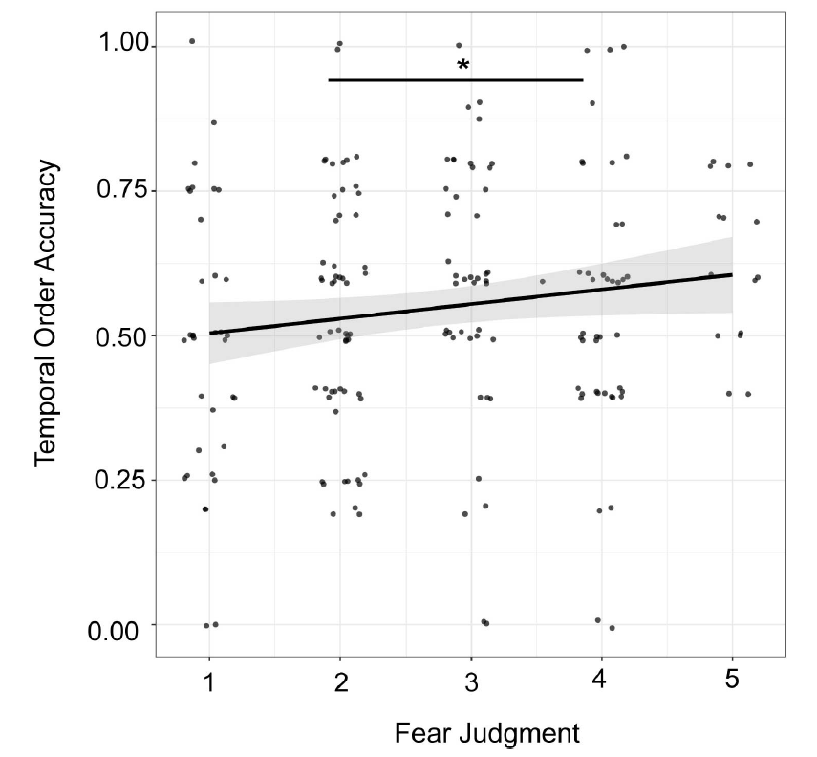
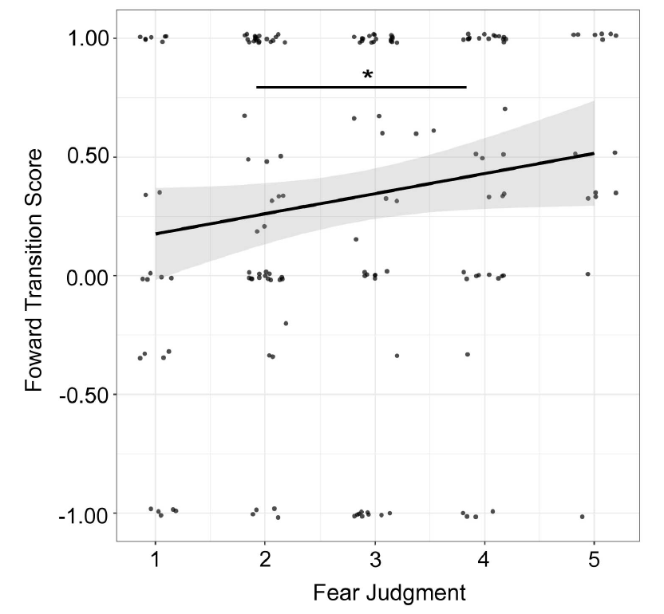
Threat improved temporal order memory (forward transitions in recall and recency discrimination judgments) ...
Forward Transition
Proportion of events recalled backwards or forwards from last event in memory
… and this was true using either objective measures of threat (i.e., pre-determined segments of the haunted house) or individually specific subjective measures of threats (i.e., fear judgments)

Slide 85
Threat improved temporal order memory (forward transitions in recall and recency discrimination judgments) ...
Forward Transition
Proportion of events recalled backwards or forwards from last event in memory
… and this was true using either objective measures of threat (i.e., pre-determined segments of the haunted house) or individually specific subjective measures of threats (i.e., fear judgments)

Slide 86
What did this project teach us happens …
During threats
After threats
Emotion regulation is complex and colored by environmental affordances
Memory accuracy improves for some things and worsens for others
Memory for temporal order and item-temporal order context actually seems to improve under threat

Slide 87
Emotional Memory Under Threat
Stimuli with emotional meaning tend to be remembered more often, and more accurately, than neutral stimuli
Elevated heart rate has been linked to enhanced autobiographical memory and increased recall accuracy for emotion-eliciting stimuli

Slide 88
Emotional Memory Under Threat
Stimuli with emotional meaning tend to be remembered more often, and more accurately, than neutral stimuli
Elevated heart rate has been linked to enhanced autobiographical memory and increased recall accuracy for emotion-eliciting stimuli
High levels of Norepinephrine – a primary neurotransmitter produced during stress – are associated with enhanced memory for emotional stimuli.

Slide 89
Emotional Memory Under Threat
Stimuli with emotional meaning tend to be remembered more often, and more accurately, than neutral stimuli
Elevated heart rate has been linked to enhanced autobiographical memory and increased recall accuracy for emotion-eliciting stimuli
High levels of Norepinephrine – a primary neurotransmitter produced during stress – are associated with enhanced memory for emotional stimuli.
Individuals report decreased intensity when applying discrete emotion labels to affective images relative to when the images are viewed without being labeled.

Slide 90
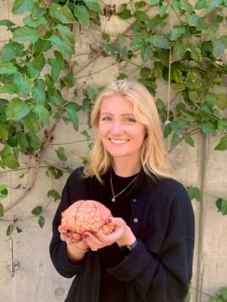
Emotional Memory Under Threat
Stimuli with emotional meaning tend to be remembered more often, and more accurately, than neutral stimuli
Elevated heart rate has been linked to enhanced autobiographical memory and increased recall accuracy for emotion-eliciting stimuli
High levels of Norepinephrine – a primary neurotransmitter produced during stress – are associated with enhanced memory for emotional stimuli.
Individuals report decreased intensity when applying discrete emotion labels to affective images relative to when the images are viewed without being labeled.

Slide 91
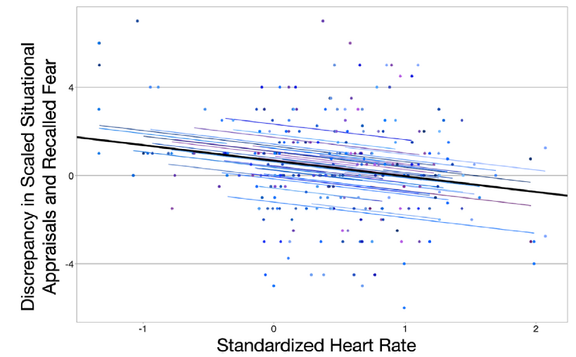
Emotional Memory Under Threat
Heart rate predicted both the intensity of reported scariness in the haunted house and meta-cognitive memory of affect during recall

Slide 92
Emotional Memory Under Threat
Heart rate predicted both the intensity of reported scariness in the haunted house and meta-cognitive memory of affect during recall

Slide 93
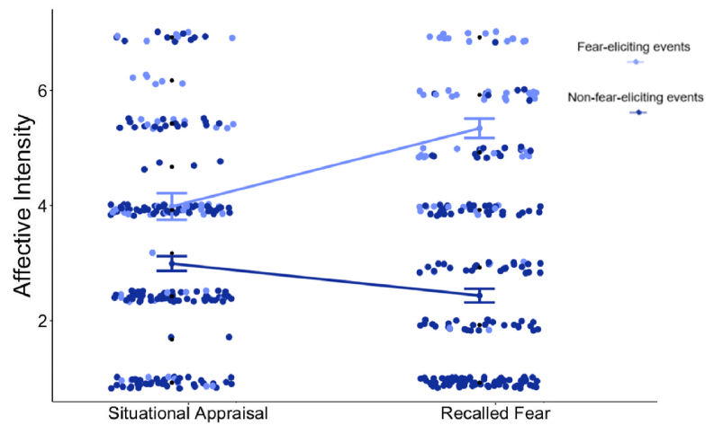
Emotional Memory Under Threat
Heart rate predicted both the intensity of reported scariness in the haunted house and meta-cognitive memory of affect during recall
Metacognitive emotional memory was malleable based on how the event was initially labeled.

Slide 94
Emotional Memory Under Threat
Heart rate predicted both the intensity of reported scariness in the haunted house and meta-cognitive memory of affect during recall
Metacognitive emotional memory was malleable based on how the event was initially labeled.

Slide 95
Emotional Memory Under Threat
Heart rate predicted both the intensity of reported scariness in the haunted house and meta-cognitive memory of affect during recall
Metacognitive emotional memory was malleable based on how the event was initially labeled.
Individuals tended to recall events that they explicitly labeled as fear-evoking as being more intense than they reported at the time of the event.

